Slide 1

J.O.B
Leeds Clean Air Hackathon
9.24.XX

Slide 2
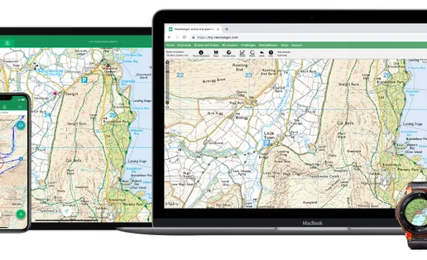
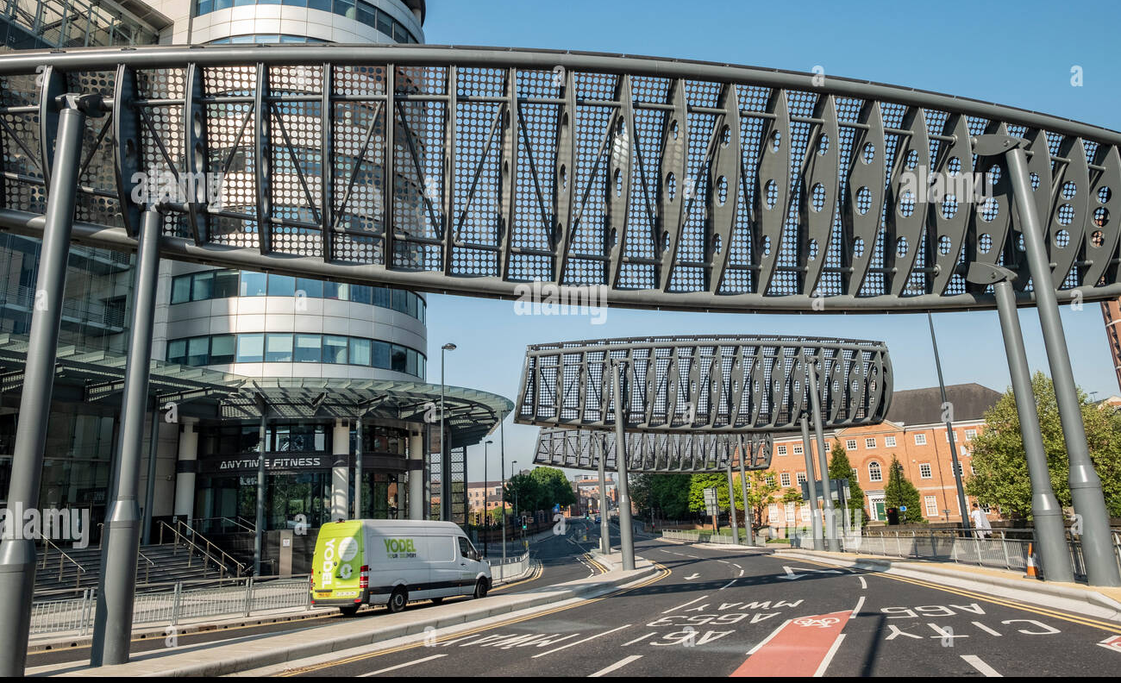
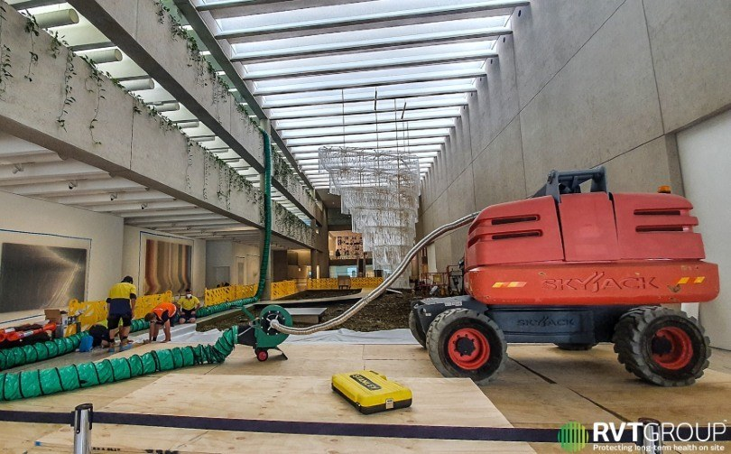
Project Ideas
Health app
Health app incentive for companies to reduce emissions
Wind Deflectors
Deflects air pollution above head height to reduce human intake.
Capture Hoods
Capture hoods on construction sites to reduce emissions

Slide 3
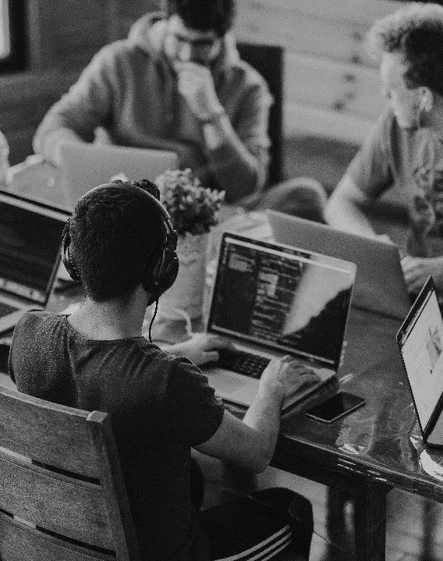
Healthy J.O.B incentive
Why Healthy J.O.B?
Why companies will incentivise Healthy J.O.B
Why people will enjoy using Healthy JOB
Cheaper
Gamified

Slide 4

Steps taken
Cycled miles
Route planning based on air pollution
Alerts for increased pollution on regular roots
Competitive
Incentivised with vouchers
Colour changing application based on location and pollution
General applications

Slide 5
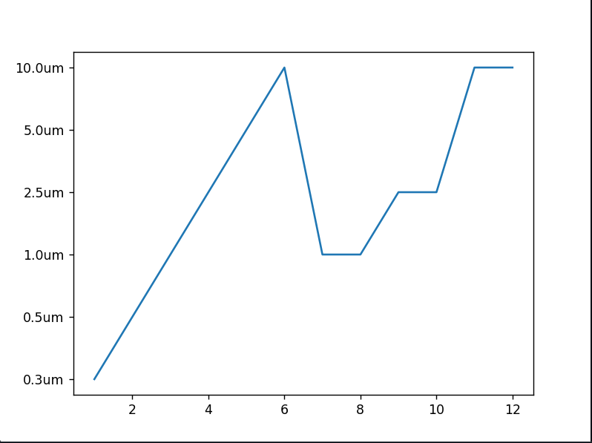
How Data will be used
Change routes based on air pollution data.
Alerts for rapidly rising pollution.
Business and authorities can see pollution in and around the city.
Tell the user what zone or air quality they are in.

Slide 6

SUMMARY
Solutions covered
Business can operate more sustainably
Migrate air pollution with diverted traffic
Not just business focused
Friend/family Groups can be made to compete
Authorities
Can collect data on foot and cycle traffic
Can see how most business traffic is diverted

Slide 7

THANK YOU
Joshua White
Oliver Long
Ben Martin
Any Question?

